Slide 1
AWS Educate Cloud 9 – Getting Started
CST370 – Design & Analysis of Algorithms
YoungJoon Byun
Computer Science

Slide 2
AWS Educate
It's an academic supporting program from Amazon.
  It’s based on a cloud computing platform called AWS (Amazon Web Services).

Slide 3
Introduction to AWS Cloud9
AWS (Amazon Web Services)
  There are many services in AWS.
  Our tool’s name is cloud9.
Cloud9 is an online IDE (Integrated Development Environment).
  You can access it from anywhere using a web browser.
  It provides a Linux-based terminal to develop C++ and Java programs.

Slide 4
Why do we use cloud9?
Cloud 9 is a Linux-based terminal.
  It’s a very powerful tool for professional software developers.
At the same time, we will use “repl.it” during the lectures.
  But it’s not secure. Everybody could see your source code, unless you use a private repl.

Slide 5
AWS Educate Account and Cloud9
You should go through several steps to set up your account and start the cloud9.
  It’s a little bit long.
  But please follow the steps one by one.
The screenshots in the following slides may be a little bit different from yours.
  However, it will not be a major issue.
  There are many screenshots with the class name CST238.
  Please consider it as CST370.

Slide 6
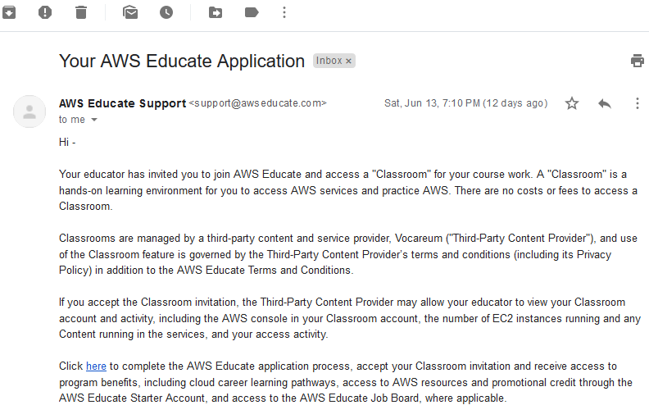
AWS Educate Account Setup (1 of 2)
You will receive an invitation email to join AWS Educate.
  Click the link in the email and follow the instruction.
  It may require your email verification.

Slide 7
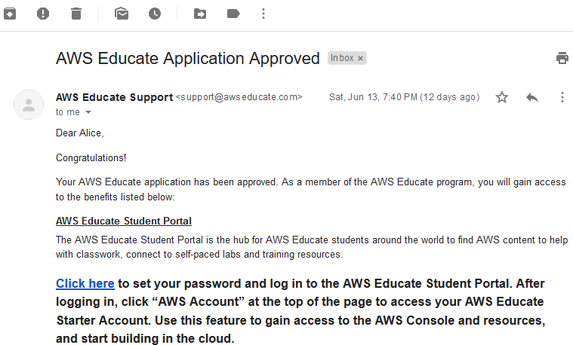
AWS Educate Account Setup (2 of 2)
Once approved, you will receive an approval email in a few days like below:

Slide 8
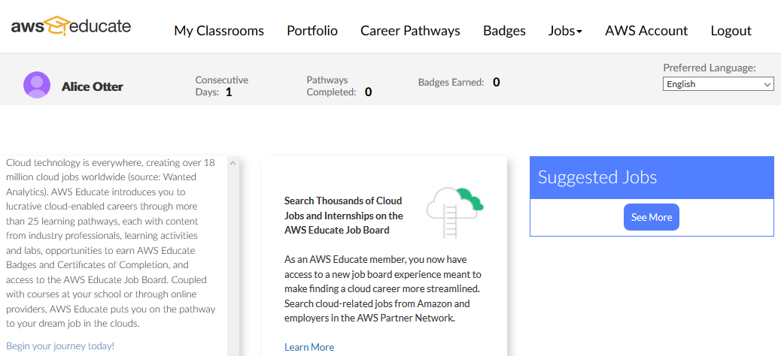
Initial Screen of AWS Educate

Slide 9
Select My Classrooms
Select this button.

Slide 10
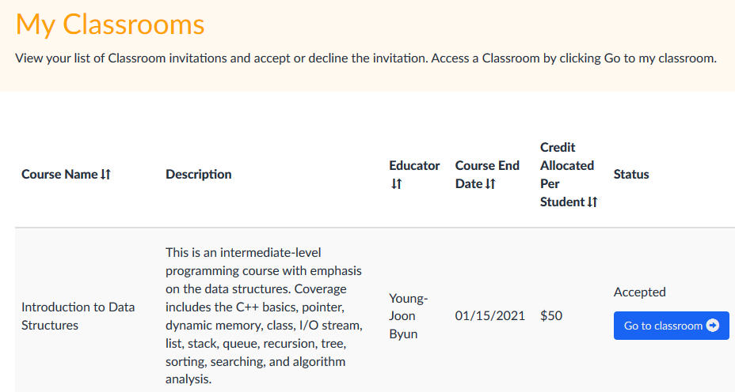
Go to classroom
Select this button and follow the instruction.

Slide 11
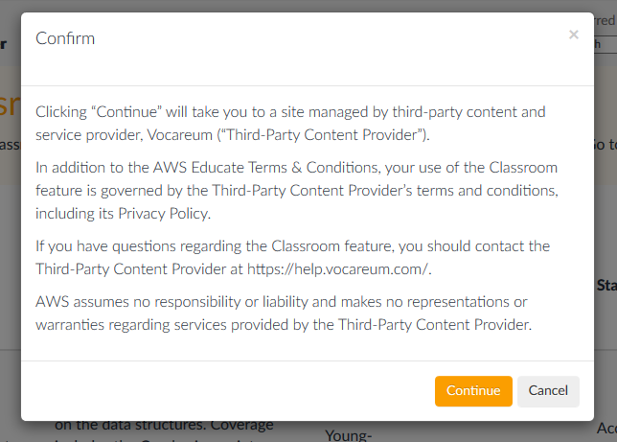
Go to classroom - Confirm
Confirm it.

Slide 12
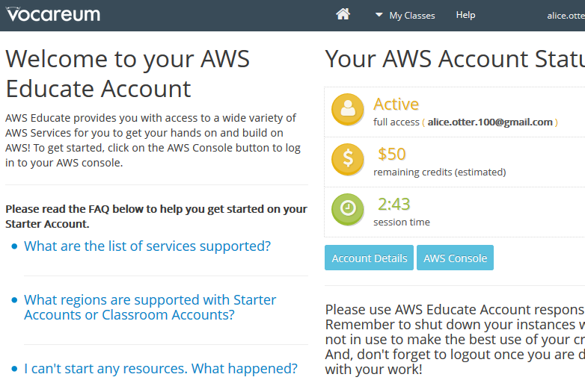
Initial Screen of Classroom – Start AWS Console
Select this.

Slide 13
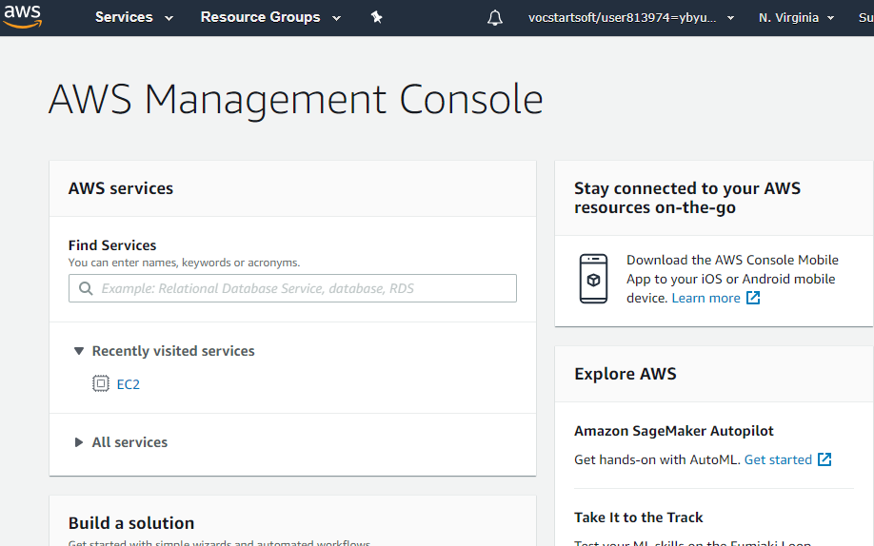
Initial Screen of AWS Management Console

Slide 14
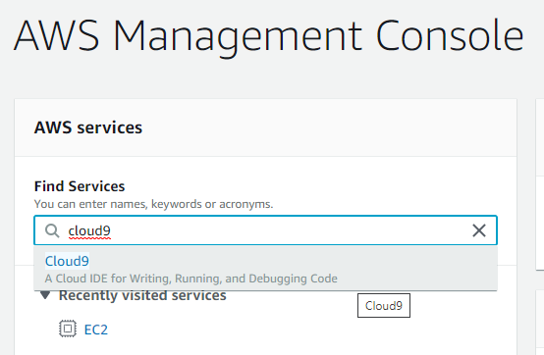
Find “cloud9” Service
1. Type “cloud9” here.
2. When “Cloud9” shows up, select it.

Slide 15
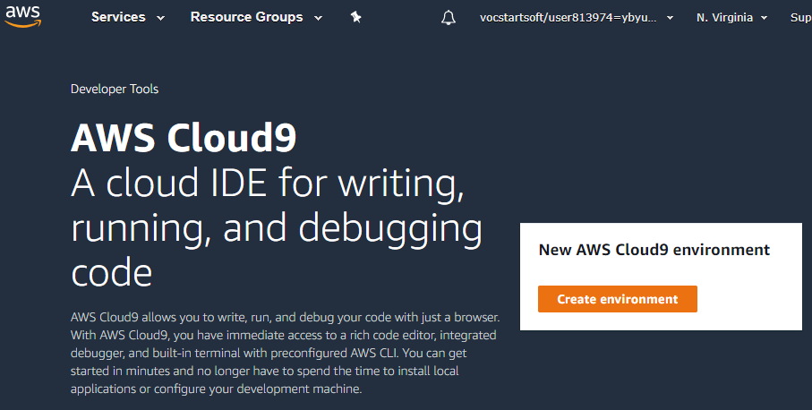
Initial Screen of “AWS Cloud9” – Create a new AWS Cloud9 environment
Select this button.

Slide 16
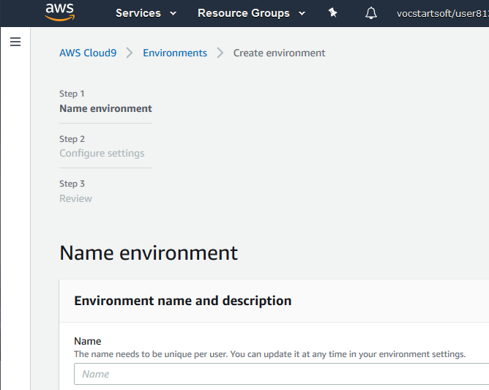
Initial Screen of Environment Creation
You can think that an “environment” is a Linux machine.

Slide 17
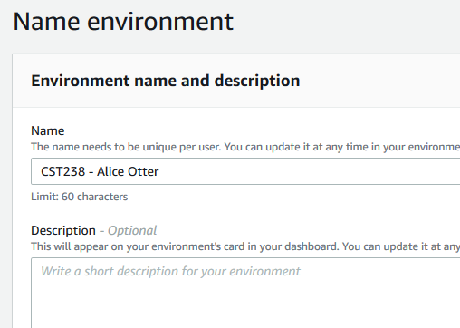
Environment Name –
Enter “CST370” and then “Your Name”
Type like this: “CST370 – Your Frist Name & Last Name”

Slide 18
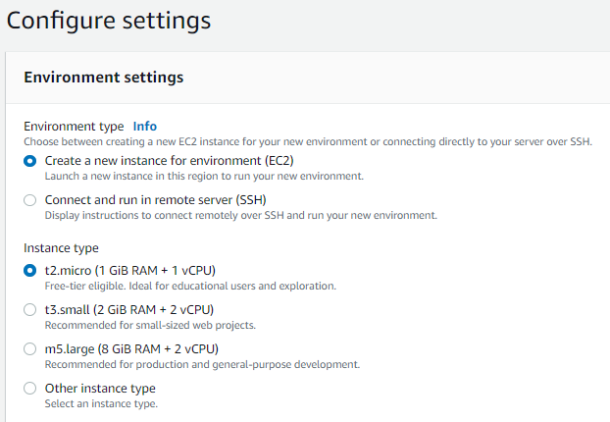
Environment settings (1 of 2)

Slide 19
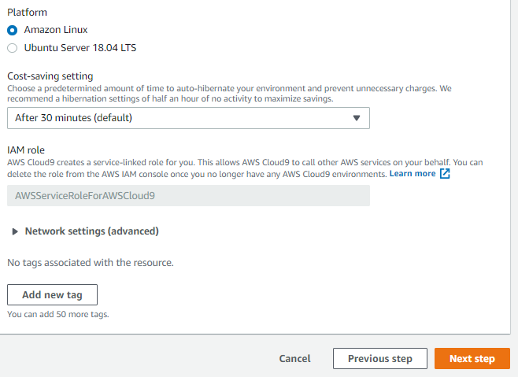
Environment settings (2 of 2)

Slide 20
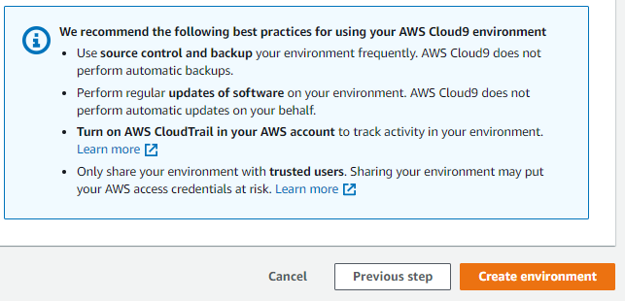
Create Environment – Review
At the end of the review page, select this button.

Slide 21
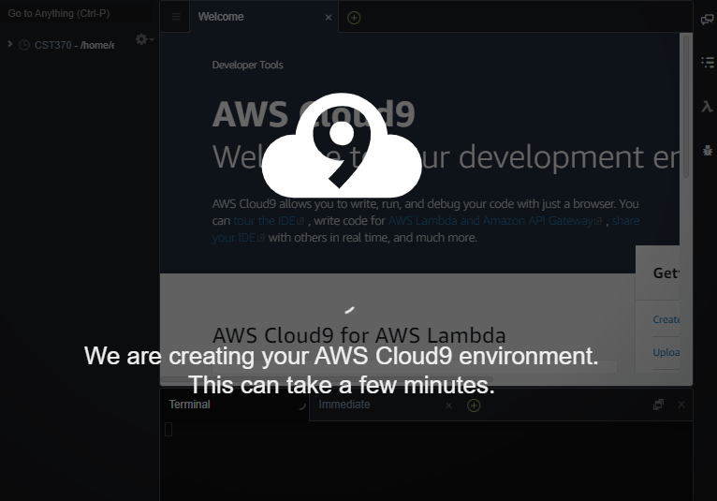
Creating Cloud9 Environment
Please wait… It could take a few minutes.

Slide 22
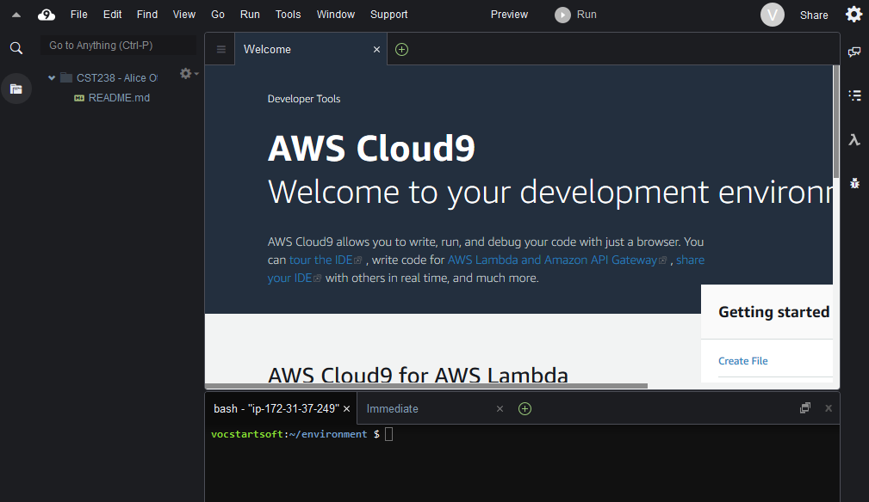
Initial Screen of AWS Cloud9

Slide 23
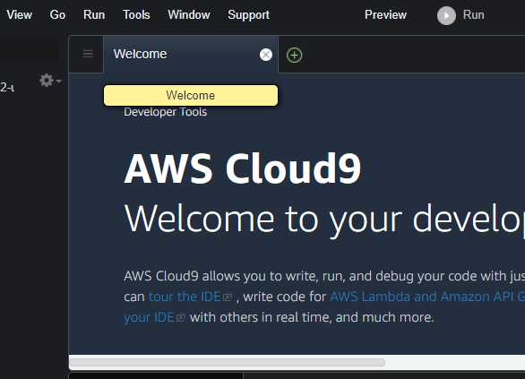
Close the Welcome Message Window
Select this button to close the welcome window

Slide 24
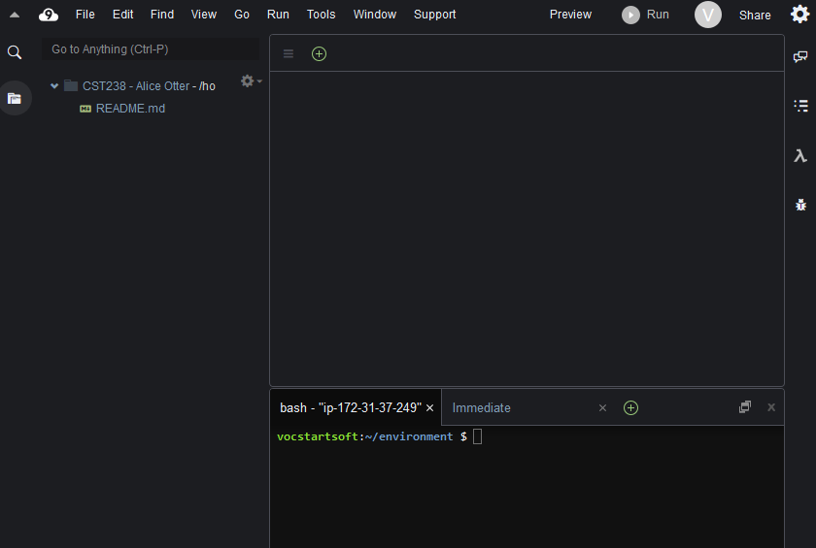
Cloud9 with Three Windows

Slide 25
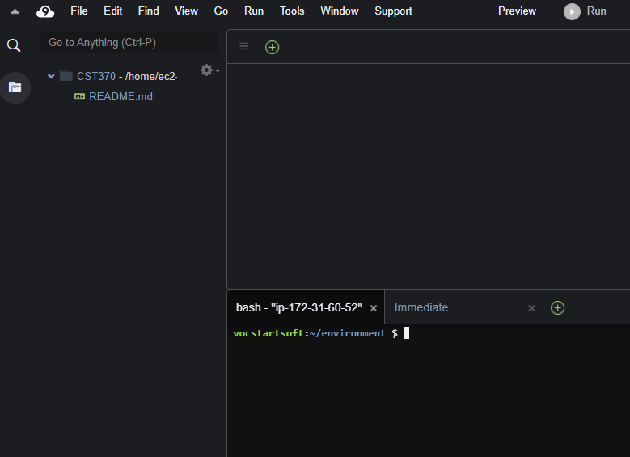
Close the bottom area window
Select this to close it

Slide 26
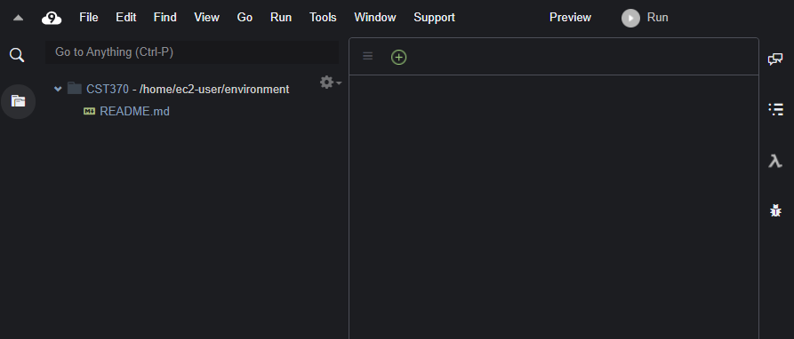
Cloud9 with Two Windows
This window is used for files and folders.
This window is used for programming and Linux commands.

Slide 27
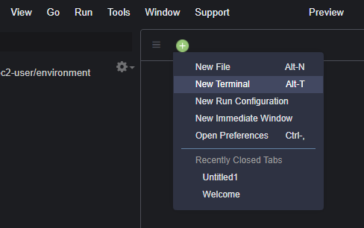
Start a New Terminal (1 of 2)
Select this button at the right window.
After that, select the option of “New Terminal”.

Slide 28
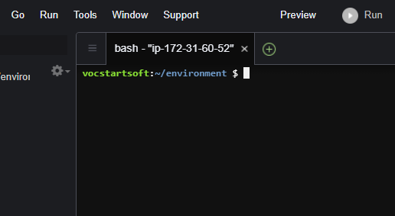
Start a New Terminal (2 of 2)
You can type Linux commands here.

Slide 29
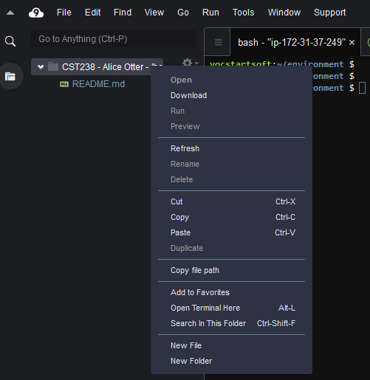
Create a C++ program named sample.cpp
1. Select the folder “CST238” with the right mouse.
2. Choose “New File”.

Slide 30
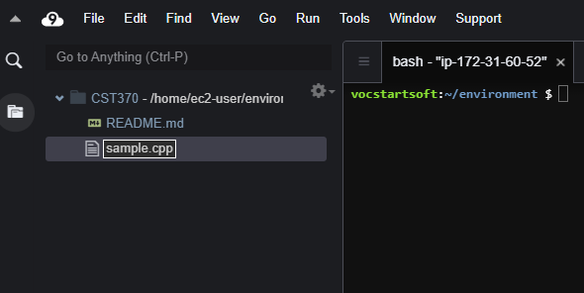
Create a C++ program named sample.cpp
Type the file name “sample.cpp”.

Slide 31
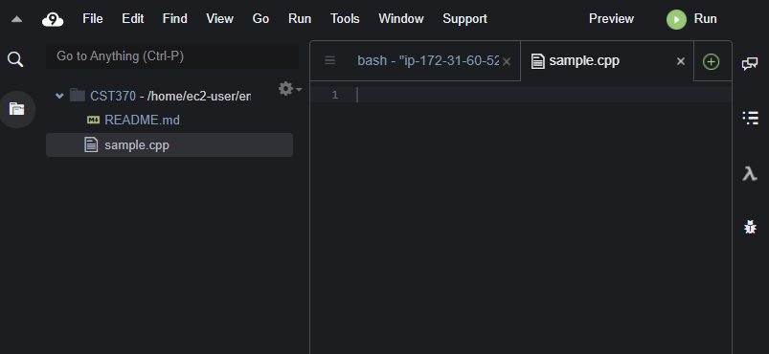
Edit the file sample.cpp (1 of 2)
1. Double-click the file to open it.
2. This is “sample.cpp”.

Slide 32
Edit the file sample.cpp (2 of 2)
Type your C++ program here.

Slide 33
sample.cpp
/*
* Title: sample.cpp
* Abstract: This program displays Hello World and g++ version on the screen.
* Author: Dr. Byun [In your case, you should write your name.]
* ID: 8899 [In your case, you have to choose a four-digit number for the class]
* Date: 08/20/2020 [Write the date you write this program.]
*/
#include <iostream>
using namespace std;
int main()
{
cout << "Hello World!\n";
cout << "g++ version: " << __GNUC__ << endl;
return 0;
}
Note that there are two underlines “_ _” before and after “GNUC”

Slide 34
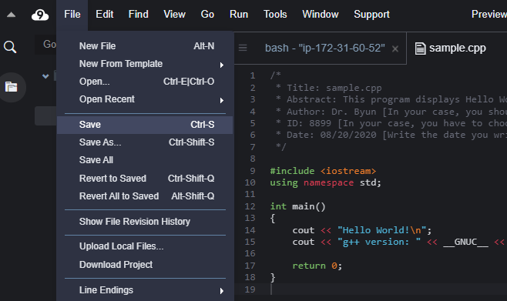
Save the program
After finishing the editing, save the file using the menu “File → Save” or key “Control-S”.

Slide 35
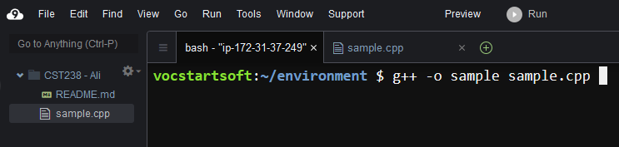
Compilation
Go to the terminal window and type the command to compile your program like below.
  Pay attention to “minus o” (= -o). It’s not minus zero.
  g++ -o sample sample.cpp
2. This is a compilation command.
1. Select this tab.

Slide 36
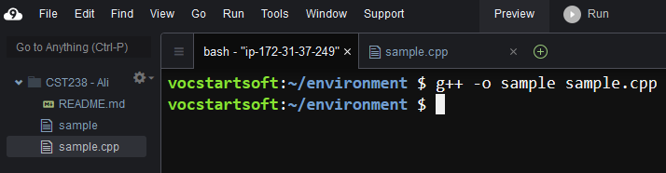
Executable File
After compilation, you can see an executable file named “sample” as below.
This is the executable file (= sample).
This is the source file (= sample.cpp).

Slide 37
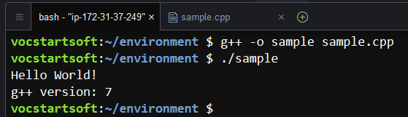
Execution
You can run the executable file by typing “./sample” at the terminal window.
  Pay attention to the dot and slash symbols (= ./)
This is a command to run.
Execution result

Slide 38
Logout Cloud9
When you finish the development, you can logout or close the browser.

Slide 39
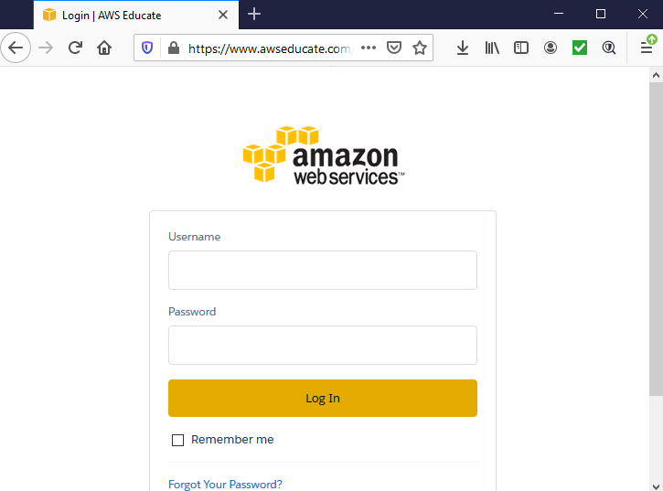
Website to Login
To login to the cloud9 again, use the following website
https://www.awseducate.com/signin

Slide 40
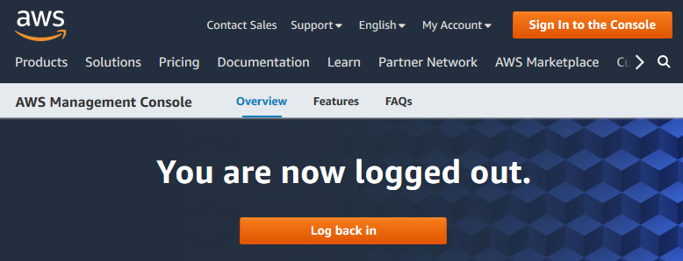
Website to Login - Important
Sometimes, AWS may direct you to a website like https://aws.amazon.com/ → NO!
  Don’t try to login through the website.
Always, login through the website
https://www.awseducate.com/signin
Also, don’t use it as well.

Slide 41
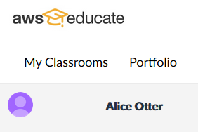
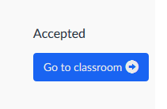
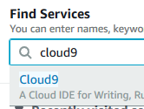

Go through “My Classrooms”, “AWS Console”, and “Cloud9”
Login at https://www.awseducate.com/signin
  Then, go through “My Classrooms” ➔ “AWS Console” ➔ “Cloud9” as you did before.
➔
➔
➔

Slide 42
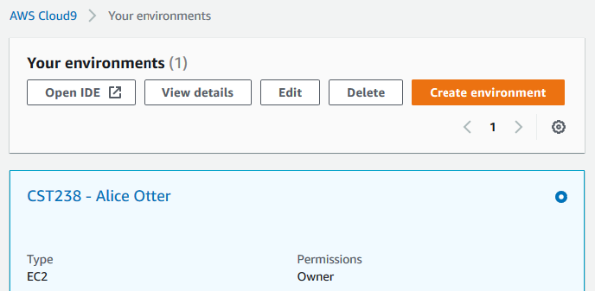
Select “Open IDE” at Cloud9 – Don’t create another new environment.
Select “Open IDE” at Cloud9 to launch it.
Select this.

Slide 43
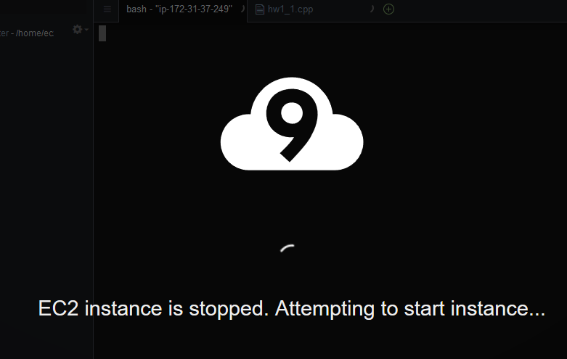
Starting your instance…

Slide 44
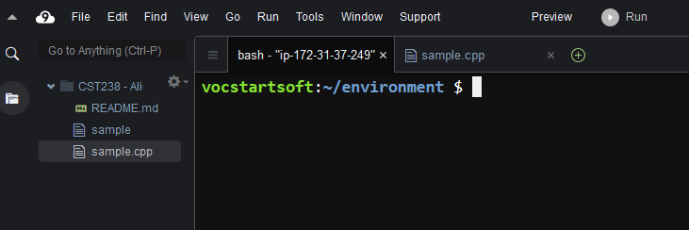
Cloud9 Environment
This is the last environment you used for the development of “sample.cpp”.
  You can continue your development here.

